Slide 1
PyLoader Tutorial
How to use Python to write tests for and interface with freeLoader machines
Updated 8/12/14
Written by Anthony McNicoll (am859@cornell.edu)

Slide 2
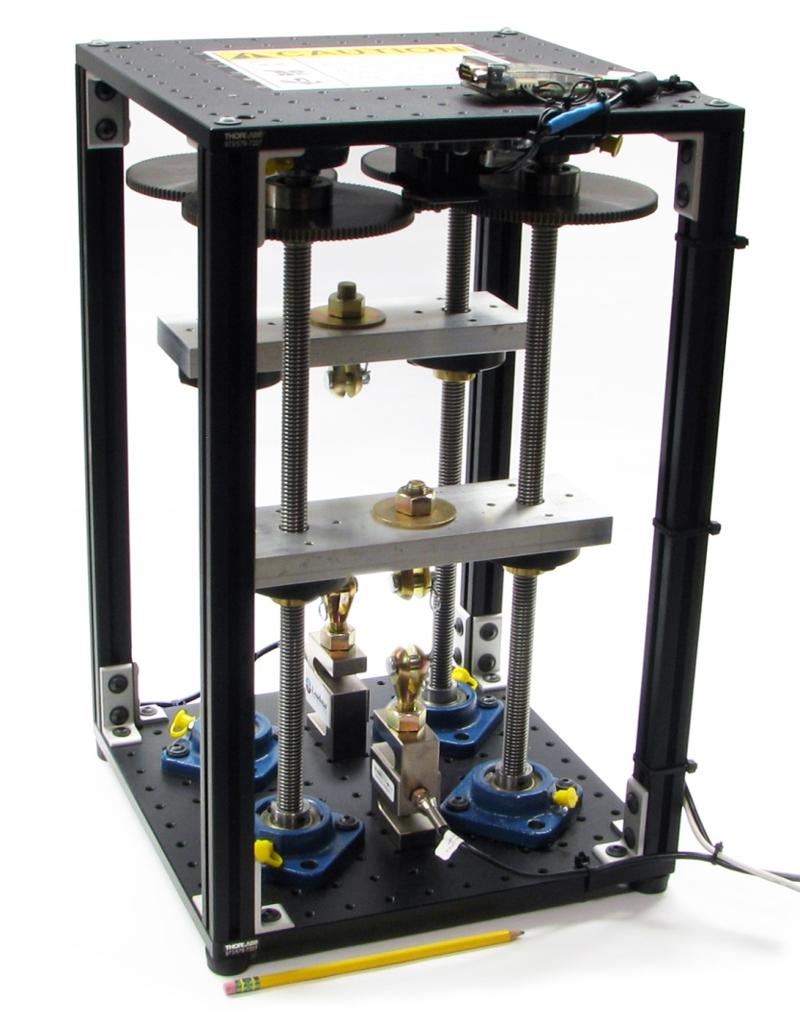
freeLoader Background
Applies + measures compressive and tensile loads
Motor is Dynamixel MX-64, communicates over serial
Load cell + interface from Loadstar, also over serial
Highly configurable

Slide 3
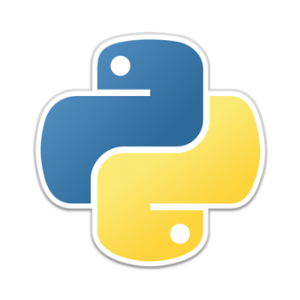
Python Background
Legible, easy to learn, well-documented, open source
Python 2.xx simply installs using one .exe file
Edit with text editor, run by double-click or command
Object oriented:
Files may contain scripts that just run
Files may also define functions
Files may also define classes:
Classes represent objects
They have attributes (values of interest)
They have methods (functions operating on that class)
Functions and classes can be imported into other files
Careful: Code blocks are defined using tabs, not braces

Slide 4
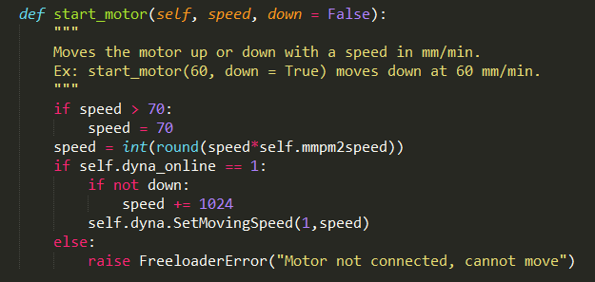
What It Looks Like
Block comments with “””, single line with #
Variables are declared implicitly, like MATLAB
Definitions, ifs, loops defined with colon and indented (4 spaces) code
Only data types of interest are string, int (round numbers) and float (decimal numbers)

Slide 5
Code Structure Overview

Slide 6
Using the Freeloader Class
Use import statement:
Create a Freeloader object and connect:
Use any of the methods defined for a Freeloader:
from freeloader import Freeloader, FreeloaderError
machine = Freeloader() # machine could be any name
machine.autoconnect() # will find motor, cell for you
machine.start_motor(30, down = True) # Go down at 30 mm/min
machine.stop_motor() # Stop the motor
machine.get_raw_encoder() # Get pos. as 0-4096
machine.get_linear_position() # Get pos. as mm
machine.reset_linear_position() # Set pos. as mm to 0
machine.read_raw_cell() # Get string from load cell
machine.read_cell() # Get load as float
machine.disconnect() # Close serial ports

Slide 7
Writing a Test using BasicTest, Part I
Things to understand:
A BasicTest is a class containing useful methods, like collect_until(), that make test writing easy
To take advantage of these, you must write a new class which inherits from a BasicTest.
From there, you must override (re-define) whatever you need for your test. At minimum, the run_test() routine must be defined.
Start by copying source code from the closest existing test
As of this writing, a tension test is available
Give your new class an appropriate name:
class NewCompTest(BasicTest): # Compression test

Slide 8
Writing a Test using BasicTest, Part II
If collecting more than load and position, you will need to override (re-define) the default collect_data method. For instance, imagine reading an analog pressure sensor:
To access the test’s Freeloader, use self.fl
You can use any Python code you want here. For example, you can connect to an Arduino and collect data from it as well.

Slide 9
Writing a Test using BasicTest, Part III
Define the run_test() routine. First, define columns and initialize the data set:
If needed, collect data from user:
Define test procedure using commands on next slide.
Call self.fl.disconnect() to safely stop things.
Build a header string if needed (see tensiontest.py)
Call self.write_file(header) to write data to a file.
self.set_columns([‘time’,’position’,’load’,’pressure’])
self.initialize_data()
max_dist = float(raw_input(“Move no further than: “))

Slide 10
BasicTest Method Quick Reference
point = self.collect_data() # get a fresh data point
lload = self.get_last_value(‘load’) # Get last value of ?
fpres = self.get_first_value(‘pressure’) # Get first value of ?
lpoint = self.get_last_point() # Get last point as list
fpoint = self.get_first_point() # Get first point as list
all_load = self.get_all_values(‘load’) # Get list of recorded ?
self.data # 2D list of all data
self.Initialize_data() # Call at test start
self.run_test() # Never call
self.collect_until(‘distance’,’lessthan’,20) # Collect until condition
self.collect_for(2.3) # Collect for time
self.wait_until(‘load’,’greaterthan’,25) # Wait until condition
self.wait_for(5) # Wait for time
self.collect_until_keyboard() # Collect until key press
self.wait_for_keyboard() # Wait for keyboard
self.write_file(“Time,Position,Load,Pressure”) # Write data file
Look at the HTML pages in the Documentation folder for complete descriptions of every method and available arguments.

Slide 11
Quickstart Python Tips
Python 3 is “newer” but not as well supported as Python 2.XX, so stick with that. I used Python 2.7. Download and install that, as well as pySerial, which are both exe’s.
You can just use Sublime Text to edit code if you have it, or Notepad++. Python programs can run by simply double-clicking the source file.
Google something like “Notepad++ Python Tabs Spaces” and make sure your editor uses spaces for tabs
For debugging, it’s useful to open a command prompt, cd to the directory your code is in, and run a command like “python basictest.py”. If there is a syntax error or exception, it will stay on the screen so you can investigate it. In Sublime, you can also hit Ctrl+B.

